Slide 1
Financial Accounting
IFRS 5th Edition
Weygandt ● Kimmel
Chapter 9
Plant Assets, Natural Resources, and Intangible Assets
This slide deck contains animations. Please disable animations if they cause issues with your device.
Copyright © John Wiley & Sons, Inc.

Slide 2
Chapter Outline
Learning Objectives
LO 1 Explain the accounting for plant asset expenditures.
LO 2 Apply depreciation methods to plant assets.
LO 3 Explain how to account for the disposal of plant assets.
LO 4 Describe how to account for natural resources and intangible assets.
LO 5Discuss how plant assets, natural resources, and intangible assets are reported and analyzed.

Slide 3
Learning Objective 2 Apply Depreciation Methods to Plant Assets.
L O 2

Slide 4
Depreciation
Process of allocating to expense the cost of a plant asset over its useful life in a rational and systematic manner.
Applies to land improvements, buildings, and equipment (i.e., with a useful life span), not land
Depreciable, because the revenue-producing ability of these assets will decline over their useful lives
Does not apply to land: its usefulness and revenue-producing ability generally remain intact over time
L O 2

Slide 5
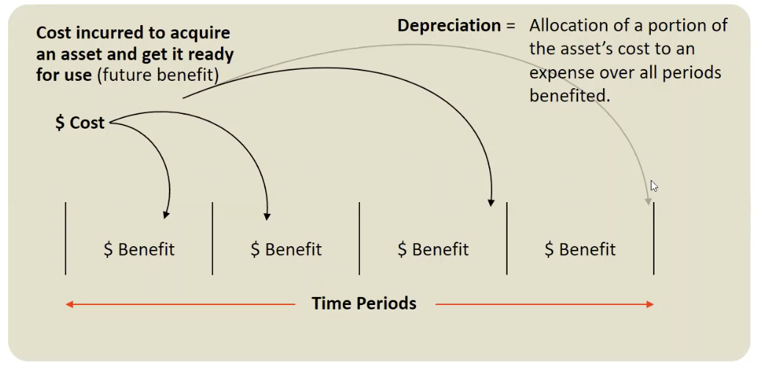
Depreciation Illustrated

Slide 6
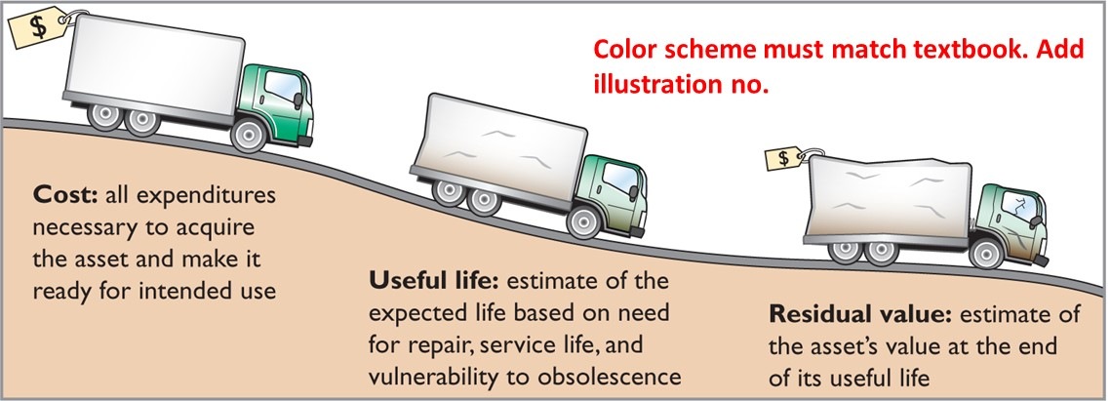
Factors in Computing Depreciation
Illustration 9.6: Three factors in computing depreciation
Depreciation expense is reported on the income statement. Accumulated depreciation is reported on the statement of financial position as a deduction from plant assets.
L O 2
Notes:
Cost: all expenditures necessary to acquire thea sset and make it ready for intended use
Talk about depreciation. Beginning of period, we estimate. Why? Before we observe actual, we need estimate to allocate costs.
Useful life: estimate expected life … we estimate!
Residual value: estimate the asset’s value at the end of its useful life.
Striaght line → allocate equal amounts in each period
Units of activity → depends on activity level.

Slide 7
Depreciation Methods
Management selects the method it believes best measures an asset’s contribution to revenue over its useful life.
Examples include:
Straight-line method
Units-of-activity method
Declining-balance method
L O 2

Slide 8
Depreciation Methods – Example Data
Compare the three depreciation methods using the following data for a small delivery truck purchased by Barb’s Florists on January 1, 2025:
Cost | €13,000
Expected residual value | €1,000
Estimate useful life in years | 5
Estimated useful life in miles | 100,000
Illustration 9.7: Delivery truck data
Required: Compute depreciation using the following.
(a) Straight-Line (b) Units-of-Activity (c) Declining Balance
L O 2

Slide 9
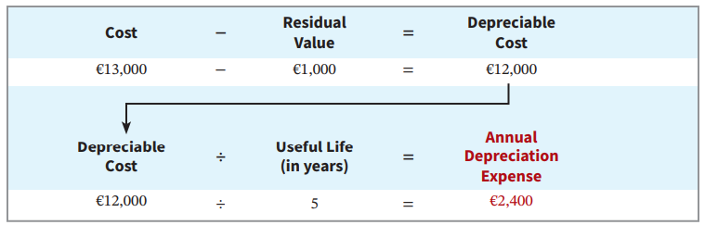
Straight-Line Method
Depreciable cost = Cost less residual value
Expense is the same amount for each year
Illustration 9.8: Formula for straight-line method
L O 2

Slide 10
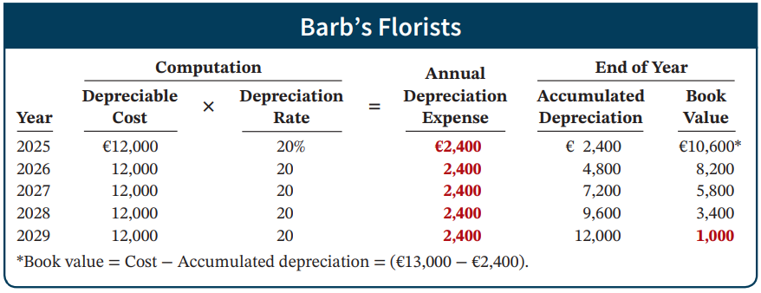
Straight-Line Method: Schedule
Illustration 9.9: Straight-line depreciation schedule
Journal entry at end of 2025:
Depreciation Expense 2,400
Accumulated Depreciation 2,400
L O 2
Notes:
Acc Dpr → how much depreciation has accumulated … this is contra asset.
BV --> Carrying value of asset … cost – acc dpr
Final BV → residual value.

Slide 11
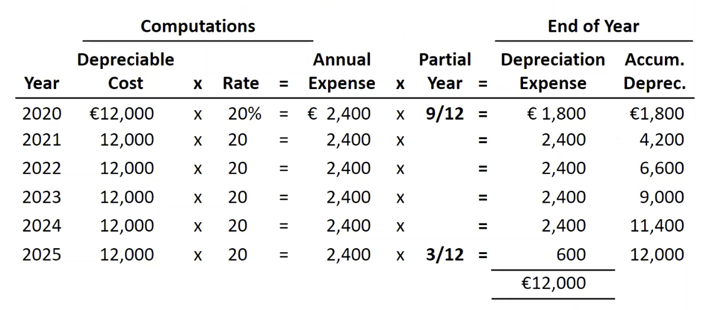
Straight-Line Continued
What if we bought the asset on 4/1/2025, instead of 1/1/2025?
Notes:
Partial years … 9 months in the beginning and 3 months at the end.

Slide 12
DO ITT! 2a: Straight-Line Depreciation
On January 1, 2025, Iron Mountain Ski Corporation purchased a new snow-grooming machine for €50,000. The machine is estimated to have a 10-year life with a €2,000 residual value. What journal entry would Iron Mountain Ski Corporation make at December 31, 2025, if it uses the straight-line method of depreciation?
L O 2

Slide 13
DO IT! 2a: Straight-Line – Solution
The entry to record the first year’s depreciation would be:
Dec. 31 | Depreciation Expense | 4,800
 | Accumulated Depreciation—Equipment |  | 4,800
 | (To record annual depreciation on snow-grooming machine)
L O 2

Slide 14
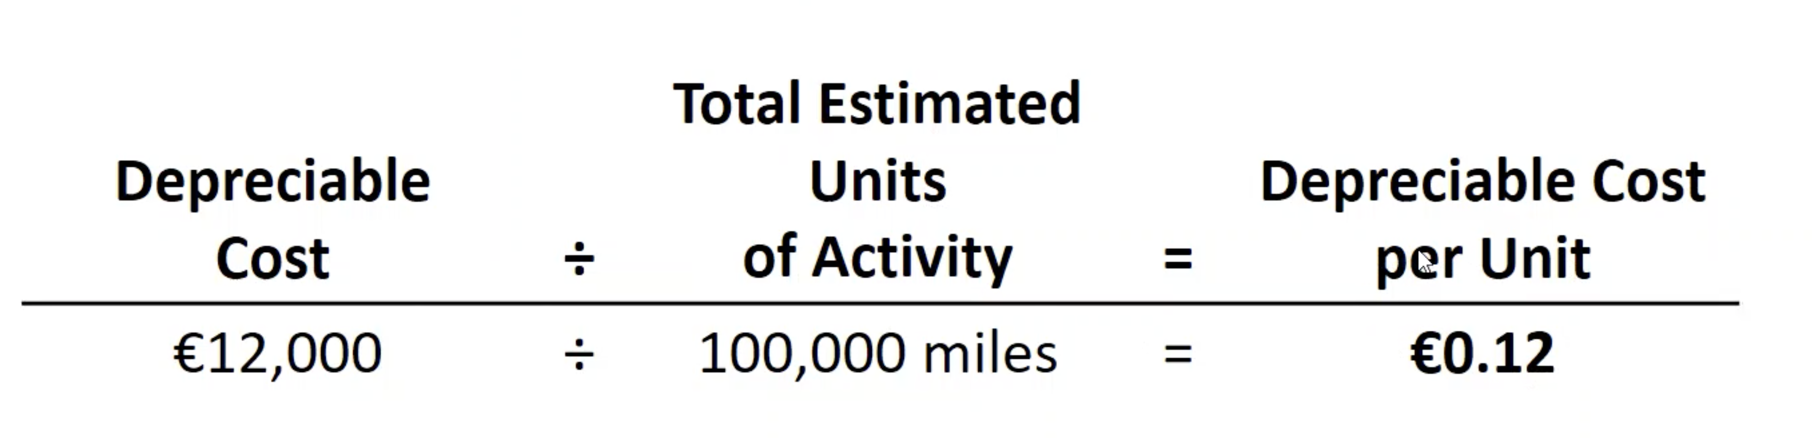
Units-of-Activity Method
Companies estimate total units of activity to calculate depreciable cost per unit
Expense varies based on units of activity
Depreciable cost is cost less salvage value
Often referred to as units-of-production method
L O 2
Notes:
When we use more, deprecaite more, use less, depreciate less! Can better match expenses with revenue.

Slide 15
Depreciation Methods – Example Data
Compare the three depreciation methods using the following data for a small delivery truck purchased by Barb’s Florists on January 1, 2025:
Cost | €13,000
Expected residual value | €1,000
Estimate useful life in years | 5
Estimated useful life in miles | 100,000
Illustration 9.7: Delivery truck data
Required: Compute depreciation using the following.
(a) Straight-Line (b) Units-of-Activity (c) Declining Balance
L O 2

Slide 16
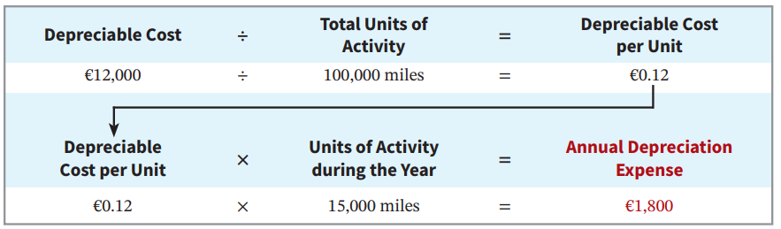
Units-of-Activity Formula
Illustration 9.10: Formula for units-of-activity method
L O 2

Slide 17
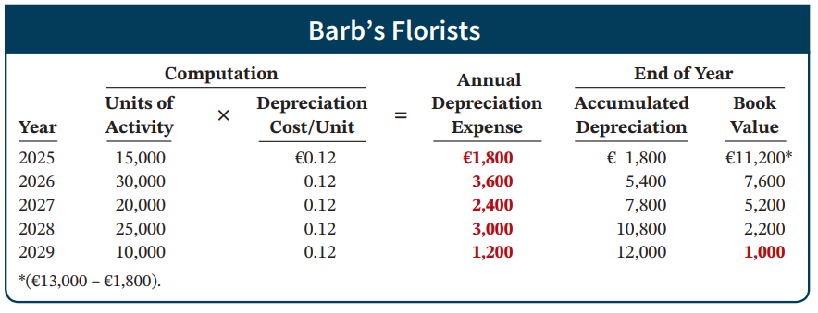
Units-of-Activity Method Schedule
Illustration 9.11: Units-of-activity depreciation schedule
Journal Entry:
Depreciation Expense 1,800
Accumulated Depreciation 1,800
L O 2
Notes:
More usage → depreciate more.
Less usage → depreciate less.
What if end of 3rd year, we reach the estimated life? What do we do? Or if we didn’t depreciate fully, what do we do?
We are allocating total cost into different periods … if we have reached, shall we further depreciate? We stop.

Slide 18
Declining-Balance Method
Accelerated method
Decreasing annual depreciation expense over asset’s useful life
There will be higher depreciation expenses in the first few years and lower expenses as the asset ages
Double declining-balance rate is double the straight-line rate (suppose straight-line method depreciate 20%, double method use 40%)
Rate applied to book value
Depreciation stops when asset’s BV equals expected residual value
L O 2
Notes:
Declining balance → accelerated method.
Decreasing annual dpr exp over useful life.
Laptop, cellphone … in beginning, provide us with more benefit in beginning. Laptop gets slower at the end … benefit it provides us is less towards end.

Slide 19
Declining-Balance Method Formula
Book Value at Beginning of Year | × | Declining-Balance Rate | = | Annual Depreciation Expense
€13,000 | × | 40% | = | €5,200
Illustration 9.12: Formula for declining-balance method
L O 2

Slide 20
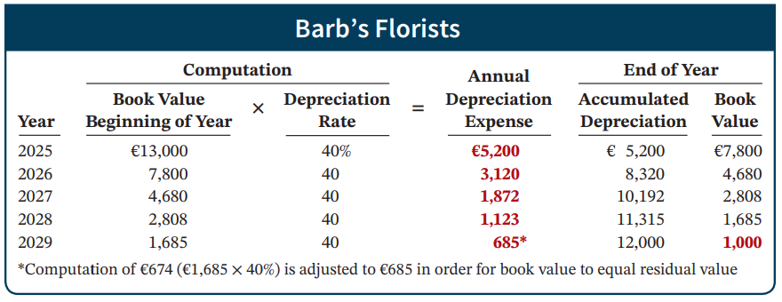
Declining-Balance Method Schedule
Illustration 9.13: Double-declining-balance depreciation schedule
L O 2
Notes:
13000 – 5200 = 7800…. This is yr 1.
Beg BV → 7800 * 40% = Depr Exp → 3120
Last year → in total, we have 5 useful yr … beg BV = 1685, we take difference b/w beginning BV and residual value.

Slide 21
Declining-Balance Method - Purchase
Assume the delivery truck was purchased on April 1, 2025 -> depreciation only 9 month out of 12 month of 2025.
 | Computations |  |  | End of Year
Year | Beginning Book Value | x | Rate | = | Annual Expense | x | Partial Year | = | Depreciation Expense | Accum. Deprec.
2025 | €13,000 | x | 40% | = | € 5,200 | x | 9/12 | = | € 3,900 | €3,900
2026 | 9,100 | x | 40 | = | 3,640 | x |  | = | 3,640 | 7,540
2027 | 5,460 | x | 40 | = | 2,184 | x |  | = | 2,184 | 9,724
2028 | 3,276 | x | 40 | = | 1,310 | x |  | = | 1,310 | 11,034
2029 | 1,966 | x | 40 | = | 786 | x |  | = | 786 | 11,820
2030 | 1,180 | x | 40 | = | 472 | x |  | = | 180 ^{(a)} | 12,000
(a) Expense adjusted to €180 to result in residual value of €1,000.
L O 2
Notes:
What if iin 3rd year, we allocated total depreciable cost? Then we stop depreciating.

Slide 22
Comparison of Methods
Year | Straight-Line | Units-of-Activity | Declining-Balance
2025 | € 2,400 | € 1,800 | € 5,200
2026 | 2,400 | 3,600 | 3,120
2027 | 2,400 | 2,400 | 1,872
2028 | 2,400 | 3,000 | 1,123
2029 | 2,400 | 1,200 | 685
 | €12,000 | €12,000 | €12,000
Illustration 9.14: Comparison of depreciation methods
Annual depreciation expense varies, but total depreciation expense is the same (€12,000) for the five-year period.
L O 2
Notes:
Is net income affected? NI will be affected and so will assets (due to accumulated depr) … choosing different methods will affect assets and net income for certain periods.

Slide 23
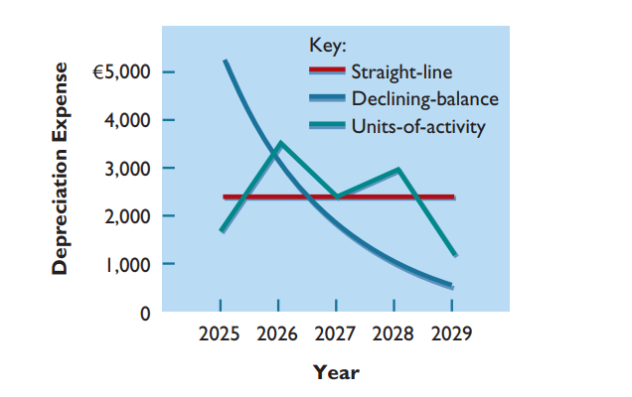
Comparison of Methods - Graph
Illustration 9.15: Patterns of depreciation
L O 2

Slide 24
Component Depreciation
IFRS requires component depreciation for plant assets
Any significant parts of a plant asset that have significantly different estimated useful lives should be separately depreciated
L O 2

Slide 25
Component Depreciation Example
Illustration: Lexure Construction builds an office building for HK$4,000,000, not including the cost of the land. If the HK$4,000,000 is allocated over the 40-year useful life of the building, Lexure reports HK$100,000 (HK$4,000,000 ÷ 40) of depreciation per year, assuming straight-line depreciation and no residual value. However, assume that HK$320,000 of the cost of the building relates to a heating, ventilation, and air conditioning (HVAC) system and HK$600,000 relates to flooring. Because the HVAC system has a depreciable life of five years and the flooring has a depreciable life of 10 years, Lexure must use component depreciation. It must reclassify HK$320,000 of the cost of the building to the HVAC system and HK$600,000 to the cost of flooring.
L O 2
Notes:
HVAC and flooring have different depreciation.

Slide 26
Component Depreciation – Example Calculated
Assuming that Lexure uses straight-line depreciation, the following shows the computation of component depreciation for the first year of the office building.
Building cost adjusted (HK$4,000,000 − HK$320,000 − HK$600,000) | HK$3,080,000
Building cost depreciation per year (HK$3,080,000 ÷ 40) | HK$ 77,000
HVAC system depreciation (HK$320,000 ÷ 5) | 64,000
Flooring depreciation (HK$600,000 ÷ 10) | 60,000
Total component depreciation in first year | HK$ 201,000
Illustration 9.16: Component of depreciation computation
L O 2

Slide 27
Depreciation and Income Taxes
Tax laws do not require taxpayer to use the same depreciation method on the tax return that is used in preparing financial statements.
Many companies use straight-line in their financial statements to maximize net income.
Depreciation for tax purposes need not equal depreciation for financial reporting purposes.
They also use an accelerated depreciation method on their tax returns to minimize their income taxes.
L O 2

Slide 28
Comparison of Methods - Graph
Illustration 9.15: Patterns of depreciation
L O 2

Slide 29
Revising Periodic Depreciation
Accounted for in period of change and future periods (Change in Estimate)
No change in depreciation reported for prior years
Not considered an error
Use a step-by-step approach:
determine new depreciable cost
divide by remaining useful life
L O 2

Slide 30
Revising Periodic Depreciation Example
Illustration: On Jan 1st, 2025, Barb’s bought the truck for €13,000, with residue value 1000, useful life 5 year.
On January 1, 2028, Barb’s Florists decides to extend the useful life of the truck by one year (a total life of six years) and increase its residual value to €2,200. The company has used the straight-line method to depreciate the asset to date. Depreciation for the first 3 years is as follows.
Equipment cost | €13,000
Residual value | − 1,000
Depreciable cost | 12,000
Useful life (original) | ÷ 5 years
Annual depreciation | € 2,400 | × 3 years = €7,200
L O 2

Slide 31
Revising Depreciation Example – Book Value
Net book value at date of change in estimate (after 3 years).
Plant Assets:
Equipment | €13,000
Accumulated depreciation | 7,200
Net book value | € 5,800
L O 2

Slide 32
Revising Depreciation Example – New Amount
Calculation of depreciation expense for 2028, year 4.
Book value, 1/1/28 (€13,000 − €7,200) | €5,800
Less: New residual value | 2,200
Depreciable cost | €3,600
Remaining useful life | 3 years | (2028 − 2030)
Revised annual depreciation (€3,600 ÷ 3) | €1,200
Illustration 9.18: Revised depreciation computation
Journal entry for 2028 and future years:
Depreciation Expense 1,200
Accumulated Depreciation 1,200
L O 2

Slide 33
DO IT! 2b: Revised Depreciation
Chambers Corporation purchased a piece of equipment for £36,000. It estimated a 6-year life and £6,000 residual value. Thus, straight-line depreciation was £5,000 per year [(£36,000 − £6,000) ÷ 6]. At the end of year three (before the depreciation adjustment), it estimated the new total life to be 10 years and the new salvage value to be £2,000. Compute the revised depreciation.
L O 2

Slide 34
DO IT! 2b: Revised Depreciation – Solution (1 of 2)
Calculation of depreciation expense for first 2 years.
Equipment cost | £36,000
Salvage value | − 6,000
Depreciable cost | 30,000
Useful life (original) | ÷ 6 years
Annual depreciation | £ 5,000 | × 2 years = £10,000
Net book value at date of change in estimate (after 2 years).
Plant Assets:
Equipment | £36,000
Accumulated depreciation | 10,000
Net book value | £26,000
L O 2

Slide 35
DO IT! 2b: Revised Depreciation – Solution (2 of 2)
Calculation of revised depreciation expense for remaining years.
Net book value after year 2 | £26,000
Salvage value (revised) | − 2,000
Depreciable cost | 24,000
Remaining life | ÷ 8 years
Annual depreciation | £ 3,000
Journal entry for remaining years.
Depreciation Expense 3,000
Accumulated Depreciation 3,000
L O 2

Slide 36
Learning Objective 3 Explain How to Account for the Disposal of Plant Assets.
L O 3
Notes:
Discussed purchase of equipment … then during the period of usage, hwo to allocate costs into different periods, now is the ending part… after we use it for a while, we dispose of it.

Slide 37
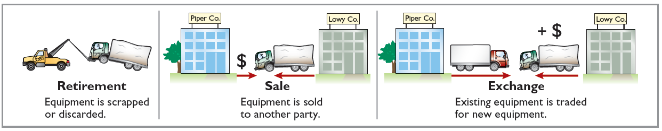
Plant Asset Disposals
Companies dispose of plant assets in three ways:
Retirement: Equipment is scrapped or discarded
Sale: Equipment is sold to another party
Exchange: Equipment is traded for new equipment (not covered)
Record depreciation up to the date of disposal.
Eliminate asset by (1) debiting Accumulated Depreciation, and (2) crediting the asset account.
Illustration 9.19: Methods of plant asset disposal
L O 3

Slide 38
Retirement of Plant Assets
No cash is received
Assume asset is fully depreciated
Decrease (debit) Accumulated Depreciation for full amount of depreciation taken over life of asset
Decrease (credit) asset account for original cost of asset
L O 3

Slide 39
Plant Asset Retirement – Example
Illustration: Hobart Publishing retires its computer printers, which cost €32,000. The accumulated depreciation on these printers is €32,000. Prepare the entry to record this retirement. This asset is fully depreciated.
Accumulated Depreciation—Equipment 32,000
Equipment 32,000
Question: What happens if a fully depreciated plant asset is still useful to the company?
Answer: Once fully depreciated, no additional depreciation should be taken, even if asset is still being used.
L O 3
Notes:
We do not have these asset anymore, so all related accounts should be closed. … if still in use, there is no depreciation (use it for free).

Slide 40
Plant Asset Discarded - Example
Illustration: Sunset Shipping discards delivery equipment that cost €18,000 and has accumulated depreciation of €14,000. The asset is retired before it is fully depreciated.
Accumulated Depreciation—Equipment 14,000
Loss on Disposal of Plant Assets 4,000
Equipment 18,000
Companies report a loss on disposal in the “Other income and expense” section of the income statement.
L O 3
Notes:
If we dispose it earlier (before fully depreciating) … effect of loss on RE … REV – COGS = GP – OP EXP = OP NI … + Gain – Loss = NI … loss reduces NI.

Slide 41
Sale of Plant Assets
Compare the book value of the asset with the proceeds received from the sale.
If proceeds exceed the book value, a gain on disposal occurs
If proceeds are less than the book value, a loss on disposal occurs
L O 3
Notes:
Retirement vs Sales … Retirement → no cash; Sales → we get cash.

Slide 42
Sale of Plant Assets – Example
Illustration: On July 1, 2025, Wright Interiors sells office furniture for €16,000 cash. The office furniture originally cost €60,000. As of January 1, 2025, it had accumulated depreciation of €41,000. Depreciation for the first six months of 2025 is €8,000. Prepare the journal entry to record depreciation expense up to the date of sale.
Depreciation Expense 8,000
Accumulated Depreciation—Equipment 8,000
L O 3

Slide 43
Sale of Plant Assets – Computing Gain
Cost of office furniture | €60,000
Less: Accumulated depreciation (€41,000 + €8,000) | 49,000
Book value at date of disposal | 11,000
Proceeds from sale | 16,000
Gain on disposal of plant asset | € 5,000
Illustration 9.20: Computation of gain on disposal
Wright records the sale as follows on July 1.
Cash 16,000
Accumulated Depreciation—Equipment 49,000
Equipment 60,000
Gain on Disposal of Plant Assets 5,000
L O 3
Notes:
Close Acc Dpr & EQ … difference between proceeds and BV → Gain

Slide 44
Sale of Plant Assets – Computing Loss
Illustration: Assume that instead of selling the office furniture for €16,000, Wright sells it for €9,000.
Cost of office furniture | €60,000
Less: Accumulated depreciation | 49,000
Book value at date of disposal | 11,000
Proceeds from sale | 9,000
Loss on disposal of plant asset | € 2,000
Illustration 9.21: Computation of loss on disposal
Cash 9,000
Accumulated Depreciation—Equipment 49,000
Loss on Disposal of Plant Assets 2,000
Equipment 60,000
L O 3

Slide 45
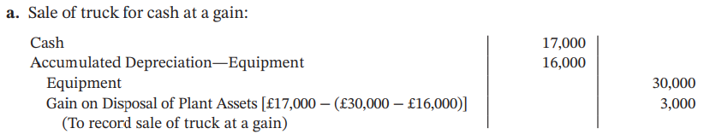
DO IT! 3: Plant Asset Disposal (a)
Overland Trucking has decided to sell an old truck that cost £30,000 and has accumulated depreciation of £16,000. (a) What entry would Overland Trucking make to record the sale of the truck for £17,000 cash?
Solution
L O 3
Notes:
Net BV = 30,000 – 16000 = 14000 … we are sellilng at higher price of 17000, so gain of 3000

Slide 46
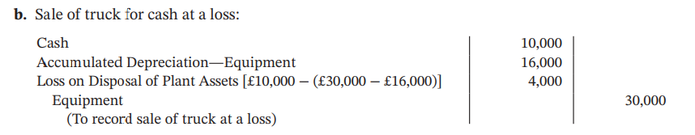
DO IT! 3: Plant Asset Disposal (b)
Overland Trucking has decided to sell an old truck that cost £30,000 and has accumulated depreciation of £16,000. (b) What entry would Overland Trucking make to record the sale of the truck for £10,000 cash?
Solution
L O 3
Notes:
Do we care about mkt value of the EQ? We record it as historical cost … when EQ leave the company (disposal date), we care about mkt price … sales price is determined by mkt price … affects gains & losses.
In between, we do not care about mkt value … we want to use it, we do not sell, so mkt price not relevant to us … this is why we apply historical cost.

Slide 47
Learning Objective 4 Describe How to Account for Natural Resources and Intangible Assets.
L O 4

Slide 48
Natural Resources and Depletion
Common Natural resources consist of standing timber and resources extracted from the ground such as oil, gas, and minerals.
Distinguishing characteristics:
Physically extracted in operations
Replaceable only by an act of nature
Cost is the price needed to acquire the resource and prepare it for its intended use.
L O 4

Slide 49
Depletion
The allocation of the cost to expense in a rational and systematic manner over the resource’s useful life.
Companies generally use units-of-activity method
Depletion generally is a function of the units extracted
L O 4

Slide 50
Depletion Illustration
Illustration: Lane Coal Company invests HK$50 million in a mine estimated to have 10 million tons of coal and no residual value. Compute the depletion cost per unit.
 | = | Depletion Cost per Unit
 | = | HK$5.00 per ton
Illustration 9.22: Computation of depletion cost per unit
L O 4

Slide 51
Depletion Journal Entry
Illustration: Lane Coal Company invests HK$50 million in a mine estimated to have 10 million tons of coal and no residual value. In the first year, Lane extracts and sells 250,000 tons of coal. Lane computes the depletion as follows:
HK$50,000,000 ÷ 10,000,000 = HK$5.00 depletion cost per ton
HK$5.00 × 250,000 = HK$1,250,000 annual depletion
Journal entry:
Inventory (coal) 1,250,000
Accumulated Depletion 1,250,000
L O 4

Slide 52
Intangible Assets
Rights, privileges, and competitive advantages that result from ownership of long-lived assets that do not possess physical substance.
Record at cost.
Can have limited life or an indefinite life.
Common types of intangibles:
Patents | Trademarks
Copyrights | Trade names
Franchises and Licenses | Goodwill
L O 4

Slide 53
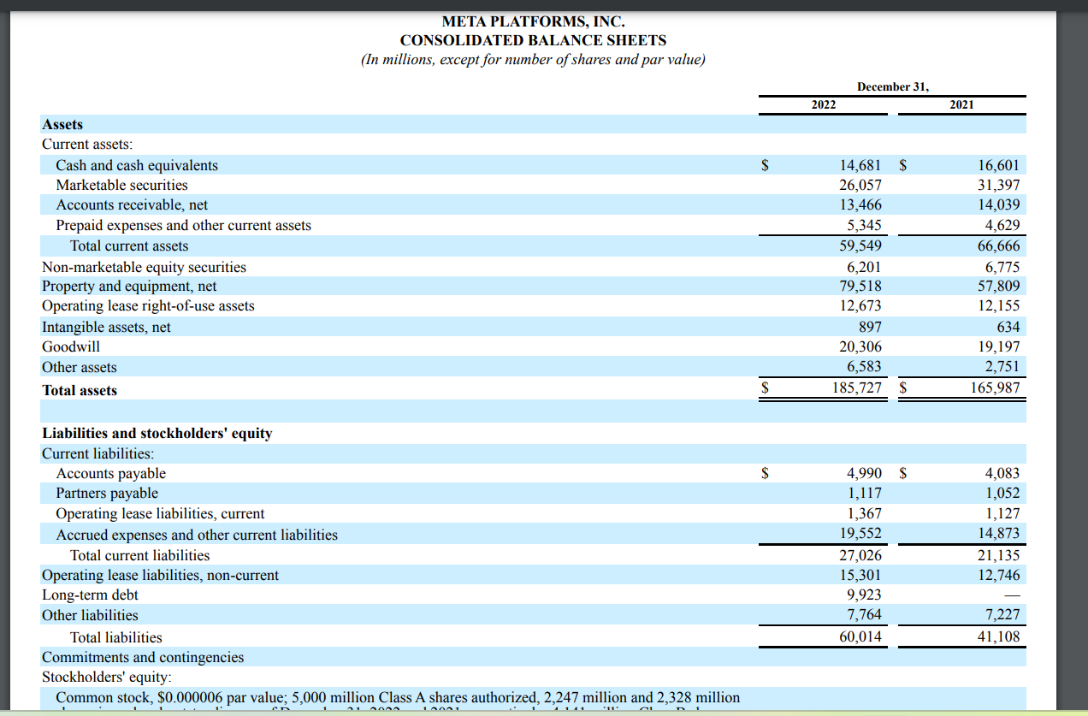
Meta’s intangible assets
Many companies will group intangible assets and goodwill together as one category in balance sheet.

Slide 54
Accounting for Intangible Assets
Limited-Life Intangibles:
Amortize to expense
Credit asset account or accumulated amortization
Indefinite-Life Intangibles:
No amortization
However, they are tested yearly for impairment.
L O 4

Slide 55
Patents
Exclusive right to manufacture, sell, or otherwise control an invention for specified number of years from the date of grant
Legal life is 20 years in many countries
Capitalize cost of a patent and amortize it over its legal or its useful life, whichever is shorter
Legal fees incurred in successfully defending a patent are capitalized to Patents account
L O 4

Slide 56
Accounting for Intangible Assets Example
Illustration: National Labs purchases a patent at a cost of NT$720,000. National estimates the useful life to be eight years. Prepare the journal entry to record the annual amortization for the year ended December 31.
Cost | NT$720,000
Useful life | ÷ 8
Amortization | NT$ 90,000
Dec. 31
Amortization Expense 90,000
Patents 90,000
L O 4

Slide 57
Copyrights
Give owner exclusive right to reproduce and sell an artistic or published work
Granted for life of creator plus a specified number of years (70 years in most countries)
Capitalize costs of acquiring and defending it
Amortized to expense over its useful life, which is generally shorter than its legal life
L O 4

Slide 58
Trademarks and Trade Names
Word, phrase, jingle, or symbol that distinguishes or identifies a particular enterprise or product
Big Mac, Coca-Cola, and Jetta
Legal protection for specified number of years (often 20 years)
Registration may be renewed indefinitely as long as the trademark is in use
Capitalize acquisition costs
Indefinite life; no amortization
L O 4

Slide 59
Franchises
Contractual arrangement between a franchisor and a franchisee
CPC, Subway, and Europcar are franchises
Franchise (or license) with a limited life should be amortized to expense over its useful life
If life is indefinite, the cost is not amortized
L O 4

Slide 60
Goodwill
Includes exceptional management, desirable location, good customer relations, skilled employees, high-quality products, and harmonious relationship with labor unions
Can be identified only with the business as a whole
Only recorded when an entire business is purchased
Goodwill is recorded as the excess of purchase price over fair value of net assets acquired
Not amortized, but impairment test needed
L O 4

Slide 61


Goodwill and overpriced M&A
Firms are more likely to acquire other companies when their stock price is overpriced.
These acquisitions often fail in the long term-> good will impairment -> lower stock price
https://publications.aaahq.org/accounting-review/article-abstract/86/6/1995/3273/Overpriced-Shares-Ill-Advised-Acquisitions-and

Slide 62

Goodwill impairment and stock price

Slide 63
Research and Development Costs
Expenditures that may lead to
Patents, copyrights, new processes, new products
Costs in the research phase are expensed when incurred
Costs in the development phase are expensed until specific criteria are met, primarily that technological feasibility is achieved
Development costs incurred after technological feasibility is achieved are capitalized to Development Costs, an intangible asset
L O 4

Slide 64
LO4 Review Question
Which of the following statements is false?
If an intangible asset has a finite life, it should be amortized.
The amortization period of an intangible asset can exceed 20 years.
Goodwill is recorded only when a business is purchased.
Development costs are always expensed when incurred.
L O 4

Slide 65
LO4 – Solution
Which of the following statements is false?
If an intangible asset has a finite life, it should be amortized.
The amortization period of an intangible asset can exceed 20 years.
Goodwill is recorded only when a business is purchased.
Development costs are always expensed when incurred. (Correct)
L O 4

Slide 66


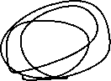
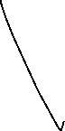
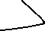


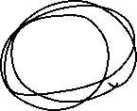
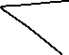

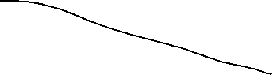
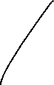
DO IT! 4: Classification Concepts
Match the statement with the term most directly associated with it.
Copyrights | Depletion
Intangible assets | Franchises
Research costs
The allocation of the cost of an intangible asset to expense in a systematic manner.
Rights, privileges, and competitive advantages that result from the ownership of long-lived assets that do not possess physical substance.
An exclusive right granted by a government to reproduce and sell an artistic or published work.
A right to sell certain products or services, or use certain trademarks or trade names within a designated geographic area.
Costs incurred by a company that often lead to patents or new products. These costs must be expensed as incurred.
L O 4

Slide 67
DO IT! 4: Classification Concepts – Solution 1 of 2
The allocation of the cost of a natural resource in a rational and systematic manner. Depletion
Rights, privileges, and competitive advantages that result from the ownership of long-lived assets that do not possess physical substance. Intangible assets
An exclusive right granted by the government to reproduce and sell an artistic or published work. Copyrights
L O 4

Slide 68
DO IT! 4: Classification Concepts – Solution 2 of 2
A right to sell certain products or services or to use certain trademarks or trade names within a designated geographic area. Franchises
Costs incurred by a company that often lead to patents or new products. These costs must be expensed as incurred. Research costs
L O 4

Slide 69
Learning Objective 5 Discuss How Plant Assets, Natural Resources, and Intangible Assets are Reported and Analyzed.
L O 5

Slide 70
Presentation
Usually, companies combine plant assets and natural resources under “Property, plant, and equipment” in the statement of financial position
Intangible assets are shown separately
L O 5

Slide 71
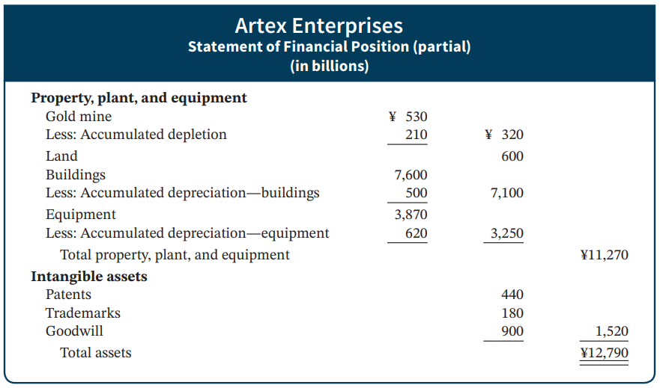
Statement Presentation
Illustration 9.23: Presentation of property, plant, and equipment, and intangible assets
L O 5

Slide 72
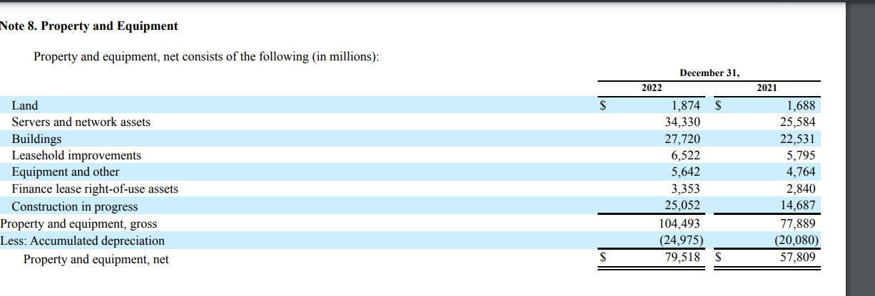
Discussion of plant assets
Construction in progress includes costs mostly related to construction of data centers, network infrastructure, servers, and office facilities. As of
December 31, 2022, construction in progress also includes $2.18 billion of servers and network assets components stored by our suppliers until required by our
design manufacturers to fulfill certain purchase orders.
Meta 10K

Slide 73
Discussion of intangible assets
“During the year ended December 31, 2022, we completed several business combinations with total cash consideration transferred of $1.23 billion, which in aggregate was allocated to $317 million of intangible assets, $1.14 billion of goodwill, and $223 million of net liabilities assumed. Goodwill generated from all business acquisitions completed was primarily attributable to expected synergies and potential monetization opportunities. The amount of goodwill generated that was deductible for tax purposes was not material. Acquisition-related costs were immaterial and were expensed as incurred. Pro forma historical results of operations related to these business acquisitions have not been presented because they are not significant to our consolidated financial statements, either individually or in aggregate. We have included the financial results of these acquired businesses in our consolidated financial statements from their respective dates of acquisition. “
Meta 10K
Illustration 9.23: Presentation of property, plant, and equipment, and intangible assets
L O 5

Slide 74
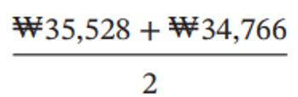
Analysis
Illustration: LG’s net sales for a recent year were ₩58,140 billion. Its total ending assets were ₩35,528 billion, and beginning assets were ₩34,766 billion.
Net Sales | ÷ | Average Total Assets | = | Asset Turnover
₩58,140 | ÷ |  | = | 1.65 times
Illustration 9.24: Asset turnover formulas and computation
Each won invested in assets produced ₩1.65 in sales. If a company is using its assets efficiently, each investment in assets will create a high amount of sales.
L O 5

Slide 75
DO IT! 5: Asset Turnover
Paramour Company reported net income of $180,000, net sales of $420,000, and had total assets of $460,000 on January 1, 2025, and total assets on December 31, 2025, of $540,000 billion. Determine Paramour’s asset turnover for 2025.
L O 5

Slide 76
DO IT! 5: Asset Turnover – Solution
The asset turnover for Paramour Company is computed as follows.
Net Sales | ÷ | Average Total Assets | = | Asset Turnover
$420,000 | ÷ |  | = | .84 times
L O 5

